Slide 1

Computational Cell & Molecular Biology
Spring 2026
Carol Wilusz [cwilusz@colostate.edu]
+ many additional instructors!
Image generated by Gemini 3 Flash, 2026

Slide 2
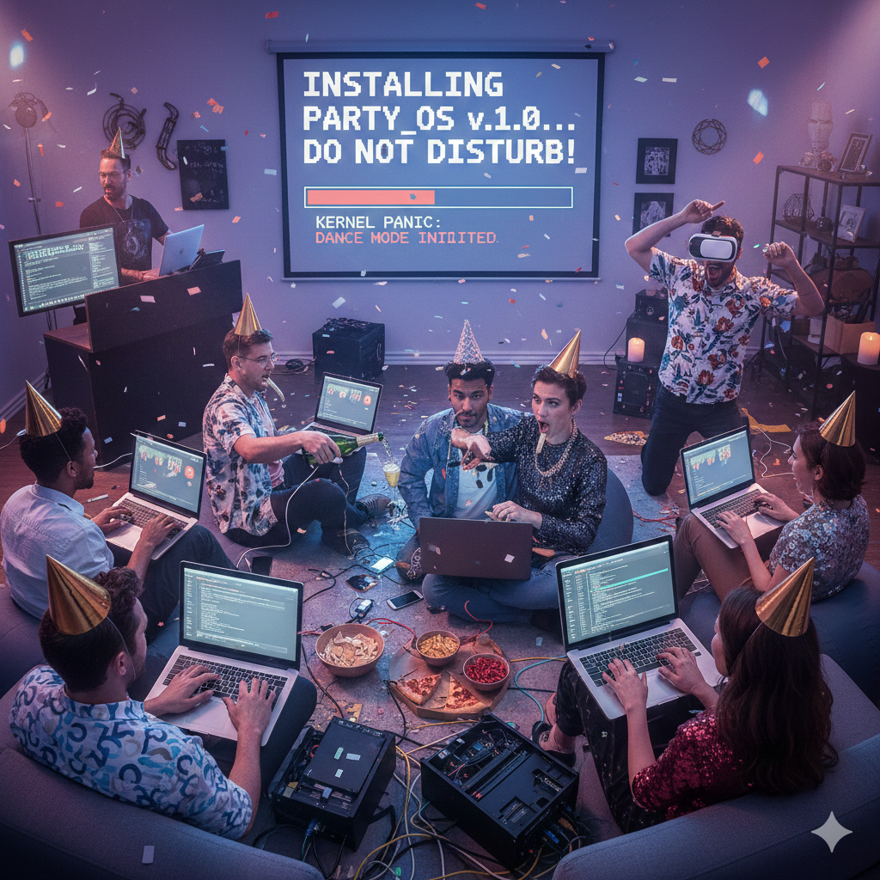
Installation
Go to Modules on Canvas:
Follow instructions for Mac or Windows to install:
Anaconda/Miniconda
VS Code
Git
Github Desktop
Request an Alpine Account
Set up your Python Environment
Also install:
PyMol
ImageJ
R and R Studio
Needed this week – make sure you have them and they work
These are needed later in the course
Image generated by Gemini 3 Flash, 2026

Slide 3
Introductions
Name
Graduate Program & Degree
Department (if different than Grad Program) & Lab
Brief description of research project (if you have one)

Slide 4
The Instructors:
Name | Email | Name | Email
Carol Wilusz | Carol.Wilusz@colostate.edu | Kira Kapit | Kira.Kapit@colostate.edu
Tai Montgomery | Tai.Montgomery@colostate.edu | Alex Alon | Alex.Alon@colostate.edu
Dan Sloan | Dan.Sloan@colostate.edu | Teagan Rockwood | Teagan.Rockwood@colostate.edu
Sarah Swygert | Sarah.Swygert@colostate.edu | Pegah Eizadkhah | Pegah.Eizadkhah@colostate.edu
Marcelo Melo | Marcelo.Melo@colostate.edu | Rosi Danzman | R.Danzman@colostate.edu
Brian Munsky | Brian.Munsky@colostate.edu | Meg Hemmerlein | Megan.Hemmerlein@colostate.edu
Dmitri Svetlov | Dmitri.Svetlov@colostate.edu | Kelsey Martin | Kelsey.E.Martin@colostate.edu
Charli Geer | Charli.Geer@colostate.edu | Danielle Samson | Danielle.Samson@colostate.edu
Shady Kuster | Shady.Kuster@colostate.edu | Callie Slaughter | Callie.Slaughter@colostate.edu
Eliud Rivas | Eliud.RivasHernandez@colostate.edu | Emma Magna | Emma.Magna@colostate.edu
Melea Barahona | Melea.Barahona@colostate.edu | Owen Bevis | Owen.Bevis@colostate.edu

Slide 5
Learning Objectives
Upon completion of this course, students will be able to:
Set up and use programming and computational environments on their own computer and on remote servers
Describe and employ reproducible research practices in data carpentry including markdown and version control
Retrieve, clean, analyze and visualize biological data in a variety of formats (images, sequences etc) using appropriate tools
Use AI agents appropriately to support effective/efficient development of coding skills

Slide 6

Overarching Goals
Students will:
Appreciate the many ways coding can accelerate/support their own research
Have the confidence and motivation to delve deeper and join more advanced classes
Join a network of like-minded individuals who support reproducible research through coding
You will not become proficient at coding without considerable extra work beyond what is expected here

Slide 7
Format
Each week is 1 topic
Each day will have some lecture/presentation and some hands-on exercises/assignments
There will be some homework (not a ton)
The instructors are all experienced coders and many started coding in this class
Assignments and materials will be provided through Github
Assignments should be submitted through Canvas
Grading will occur in Canvas

Slide 8
Class Overview
Files/Folders
Command Line/ BASH / Jupyter
Github
Python
Jupyter/AI
Functions/ Loops /Conditionals
Biofiles /Data Retrieval
Eliud / Carol
Charli / Shady / Eliud
Dmitri / Kira
Kira / Alex
Kira / Alex
Tai
Protein Structure/Viz
2D Genomics
Machine Learning
Image Analysis
R / R studio
TidyR / Pipes
Teagan/Callie/Emma
Sarah
Marcelo / Pegah
Rosi / Kelsey
Owen/ Carol / Melea
Shady / Meg
ggplot / Data Viz
ggtree / Data Viz
Final Projects
Alex / Danielle
Dan
Everyone……

Slide 9
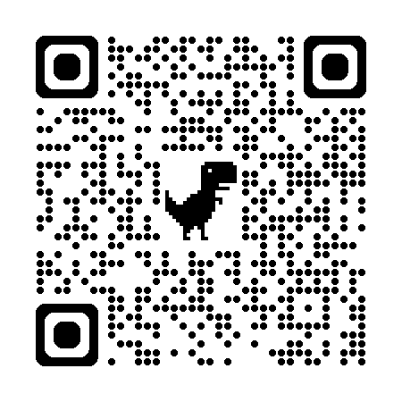
Office Hours = Coding Club
This When2Meet has possible times for Coding Club already entered (as “Instructors”) – please indicate your availability so we can pick a time

Slide 10
Grading
80% Assignments (in class plus homework)
Late work will be penalized 10% per day
10% Final Project – based on presentation
10% Attendance & Participation
2 excused absences (no penalty)
Additional or unexcused absences will be penalized

Slide 11
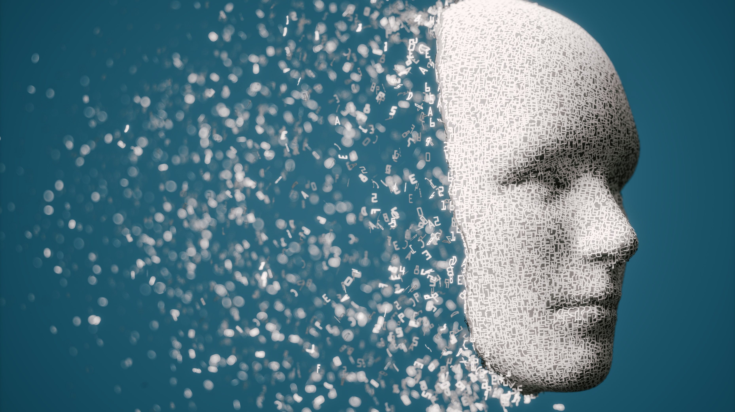
AI in CM544
Undisclosed AI use is considered academic dishonesty
Always include an AI use statement:
What tool you used (e.g. Github Copilot, ChatGPT etc)
What it contributed (e.g. code, comments, suggestions)
How you tested/validated the AI contribution
Acceptable uses:
Debugging
Explaining coding concepts
Breaking down a project into parts
Unacceptable uses:
Submitting code generated entirely by AI
Submitting code that was generated with AI help that you don’t understand or didn’t verify

Slide 12
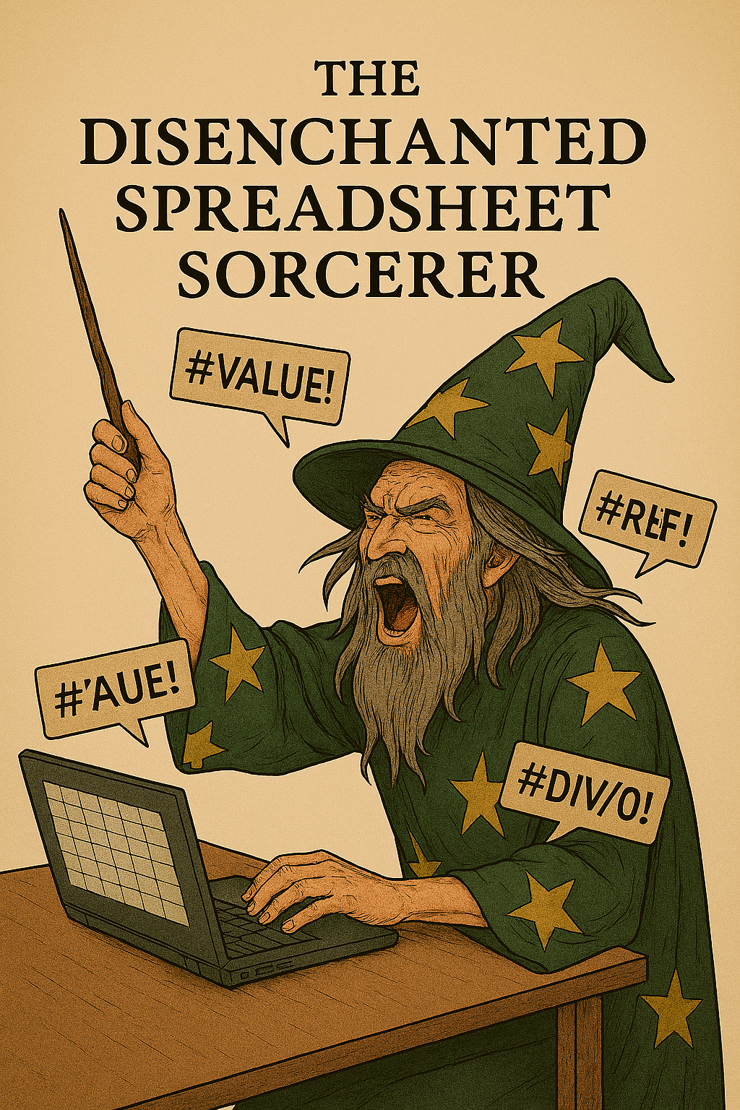
Where are you starting from?
Very comfortable with Excel
Frustrated by its limitations (dataset size, visualization etc)
Maybe you have graduated to Graphpad Prism
Haven’t really tried coding
Image generated by MS Copilot

Slide 13

Where are you starting from?
Vibe Coder
You can generate code with AI support
Can change an existing script to fit your data/project
Little formal training
OpenAI GPT-4o Generated

Slide 14

Where are you starting from?
Eager Apprentice
You dabble with a single language (R, Python, MatLab)
May or may not know the command line

Slide 15



Where do you want to go?
Save Time
Take my Project in New Directions
Become a Coder

Slide 16
Summary from Survey

Slide 17

What does all this stuff you made me put on my laptop do?

Slide 18

Where are you starting from?
Spreadsheet Sorcerer
Vibe Code Only
Eager Apprentice
Confident in one language
Probably don’t need this class

Slide 19

/ miniCONDA
What it is:
A package + environment manager for Python
Helps you INSTALL and MANAGE software
Why we use it:
To create isolated environments so everything you need is in one place
To make installing scientific libraries (NumPy, pandas, Biopython, scikit-image, Jupyter) MUCH easier
Reproducibility: everyone in class can run the same code with the same versions
Miniconda is enough for this class

Slide 20


What does all this stuff you made me put on my laptop do?
Integrated Development Environments (IDEs)
Software applications that combine all your tools for a project in one place
This is where you write, debug, test your code
Language agnostic IDE/Editor
Best for Python
Very good for R
Built-in integration with Git
Can also run Bash, Jupyter etc
Best for those working in multiple languages
IDE primarily for R
Built-in integration with Git
Can run Python
Cannot run Bash etc
Not great for Jupyter
Also a package-manager

Slide 21
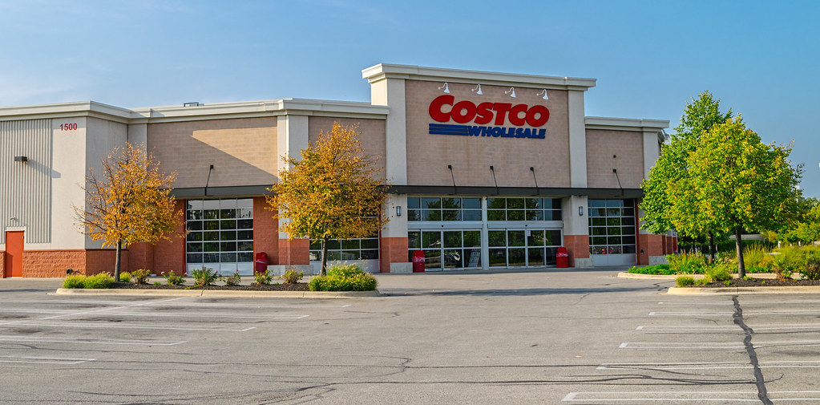
This Photo by Unknown Author is licensed under CC BY-SA-NC

Slide 22
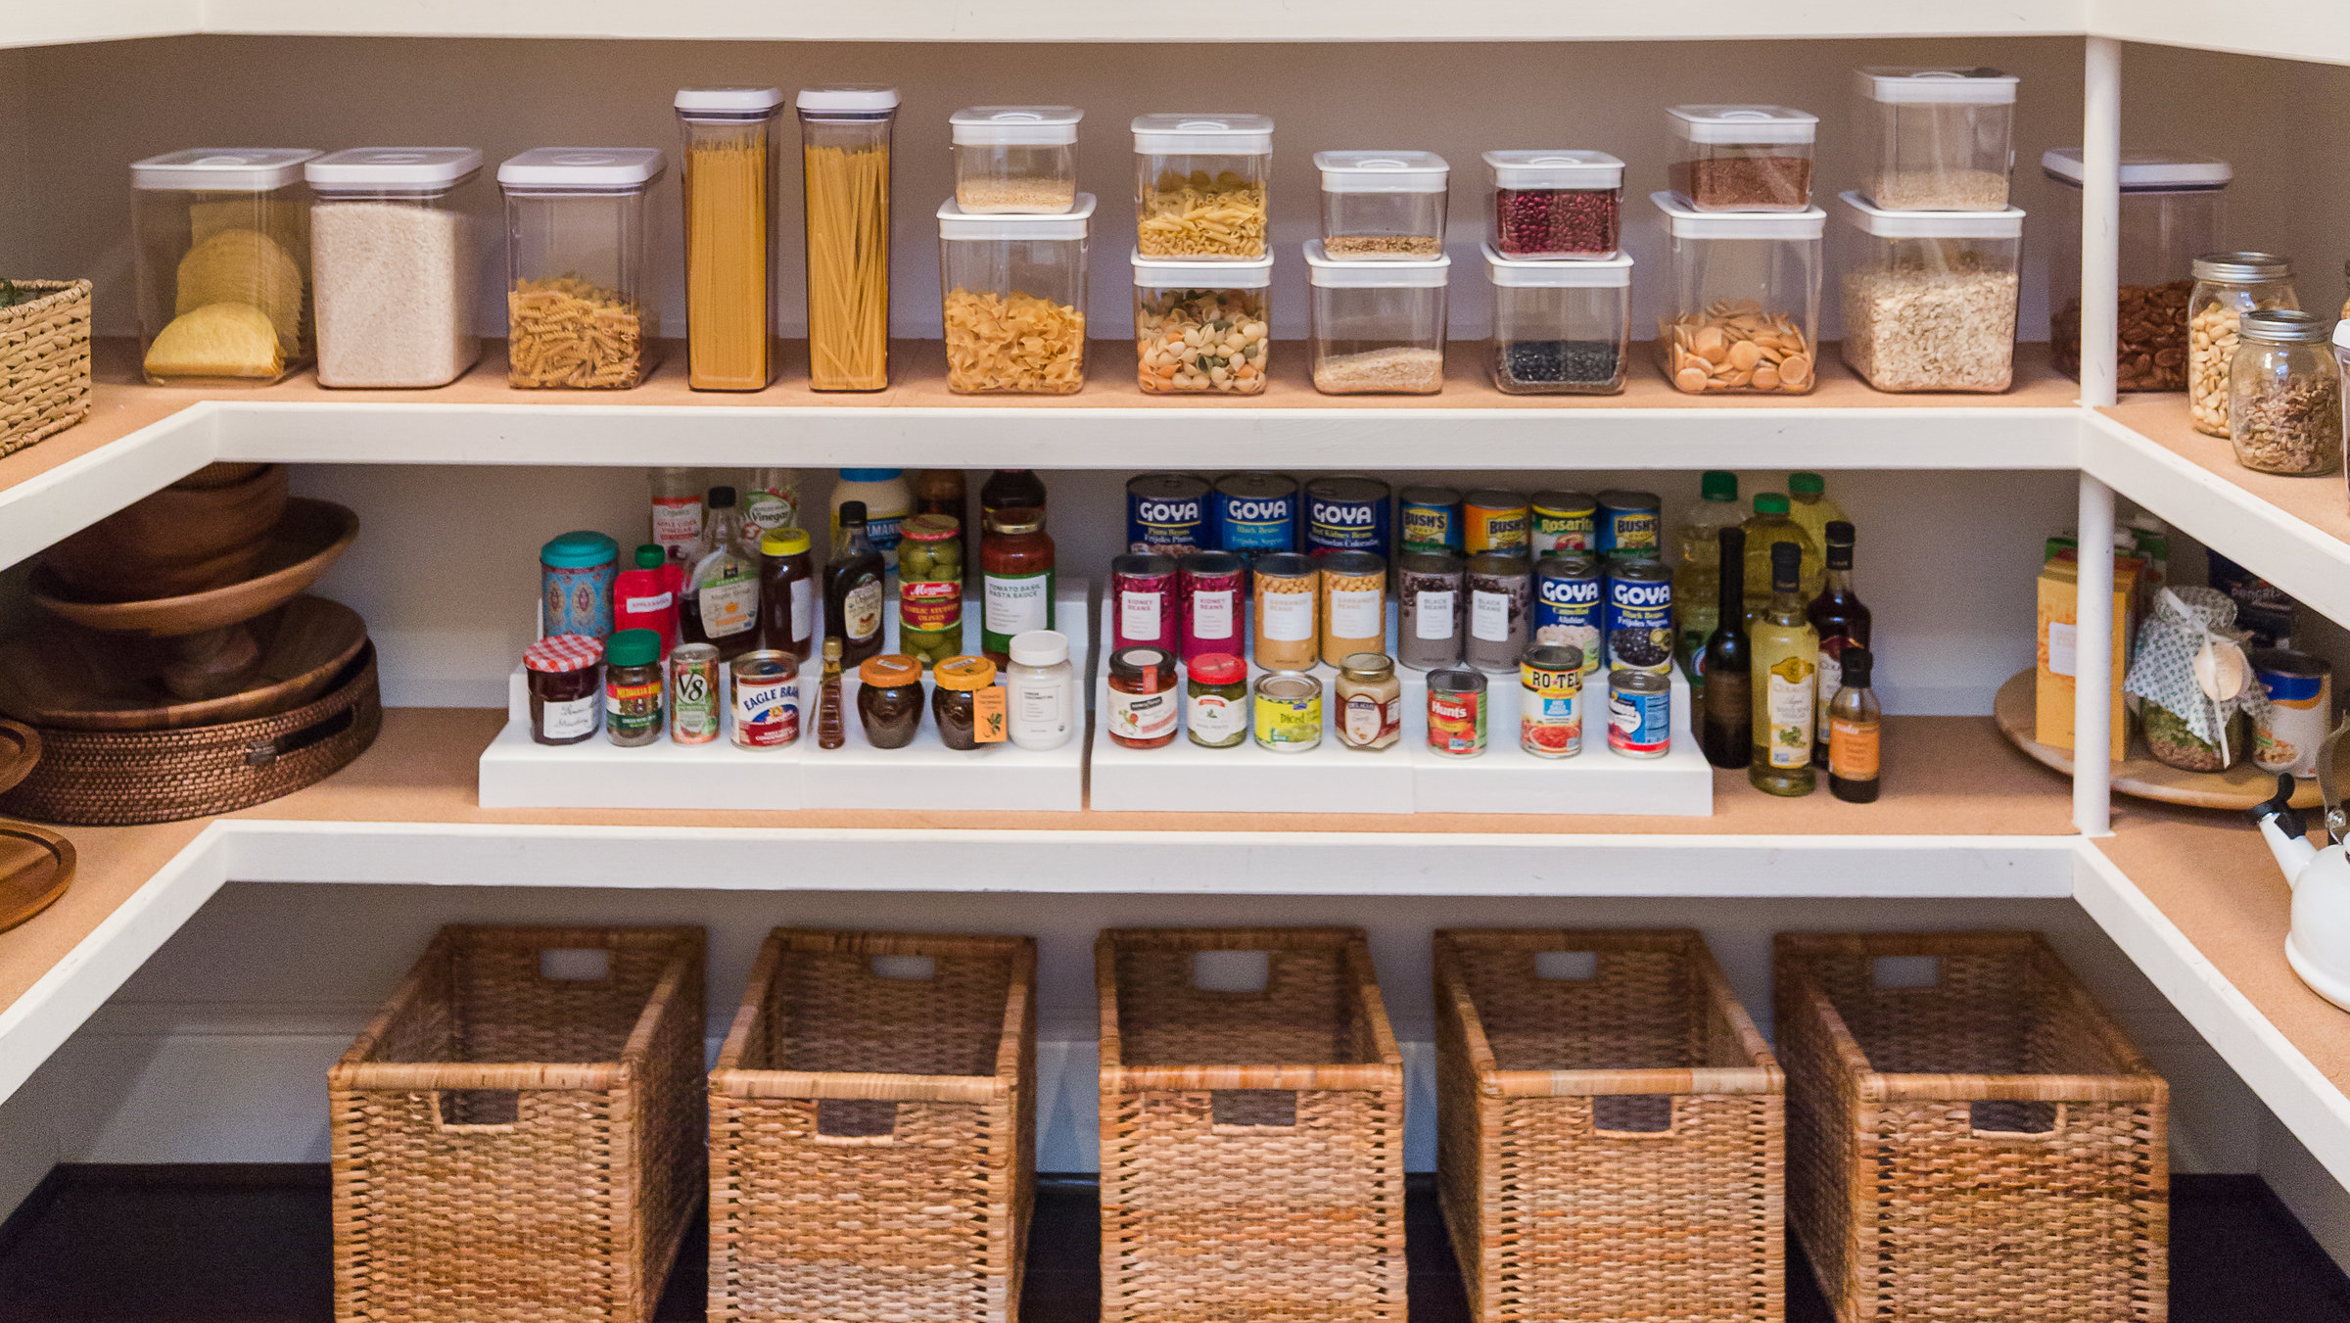
MiniCONDA is your pantry – you stock it with all the ingredients you use for cooking (packages)

Slide 23
For each project you create a new environment that contains everything needed
Coding | Kitchen
IDE (Rstudio, VSCode) | Countertop (where you cook!)
Language (executes the code) - Python, R | Appliance (does the cooking) –cooker/stove
Packages (Conda) | Ingredients
This means that anyone can replicate your environment and get the same results

Slide 24
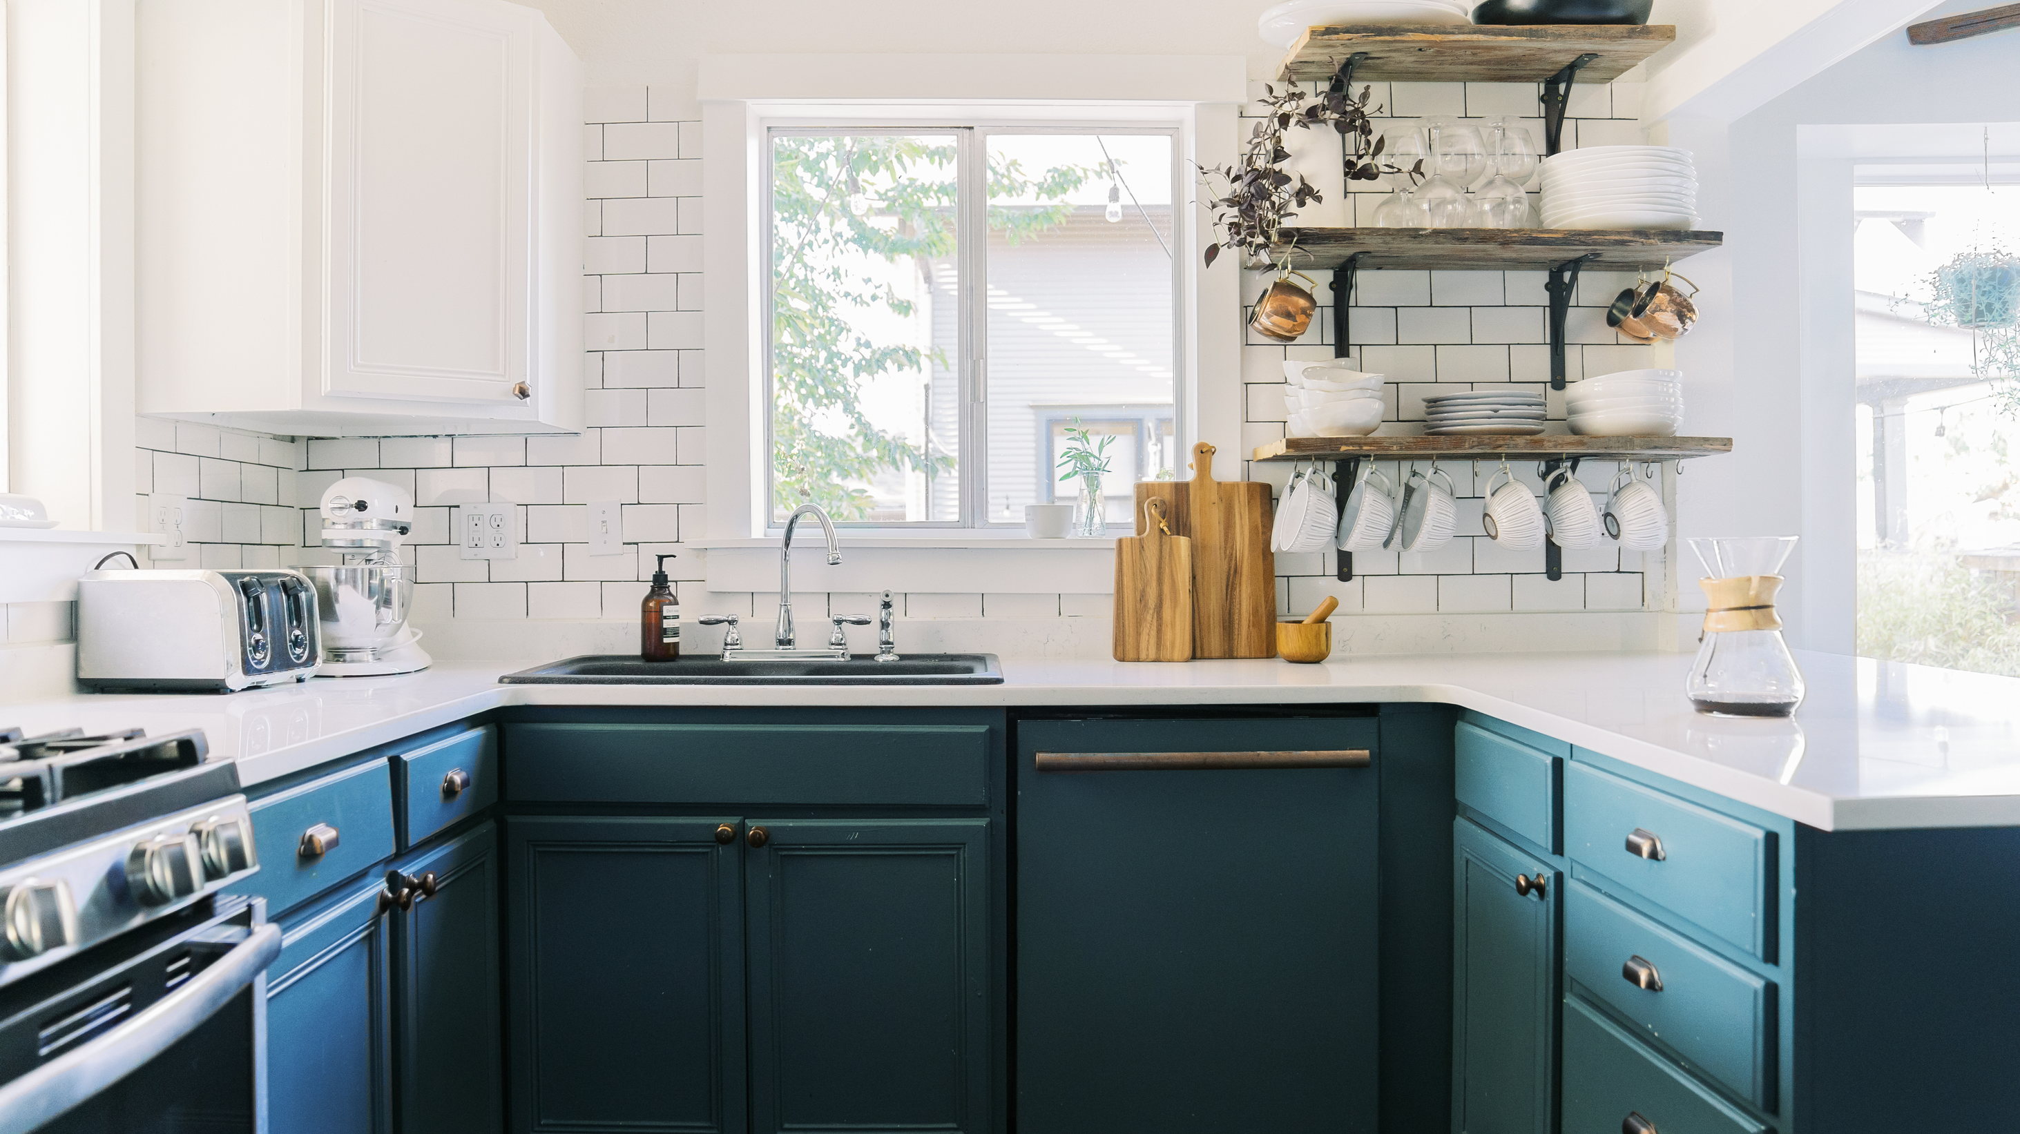




Image Analysis Kitchen (Environment)
numpy
pandas
scipy

Slide 25
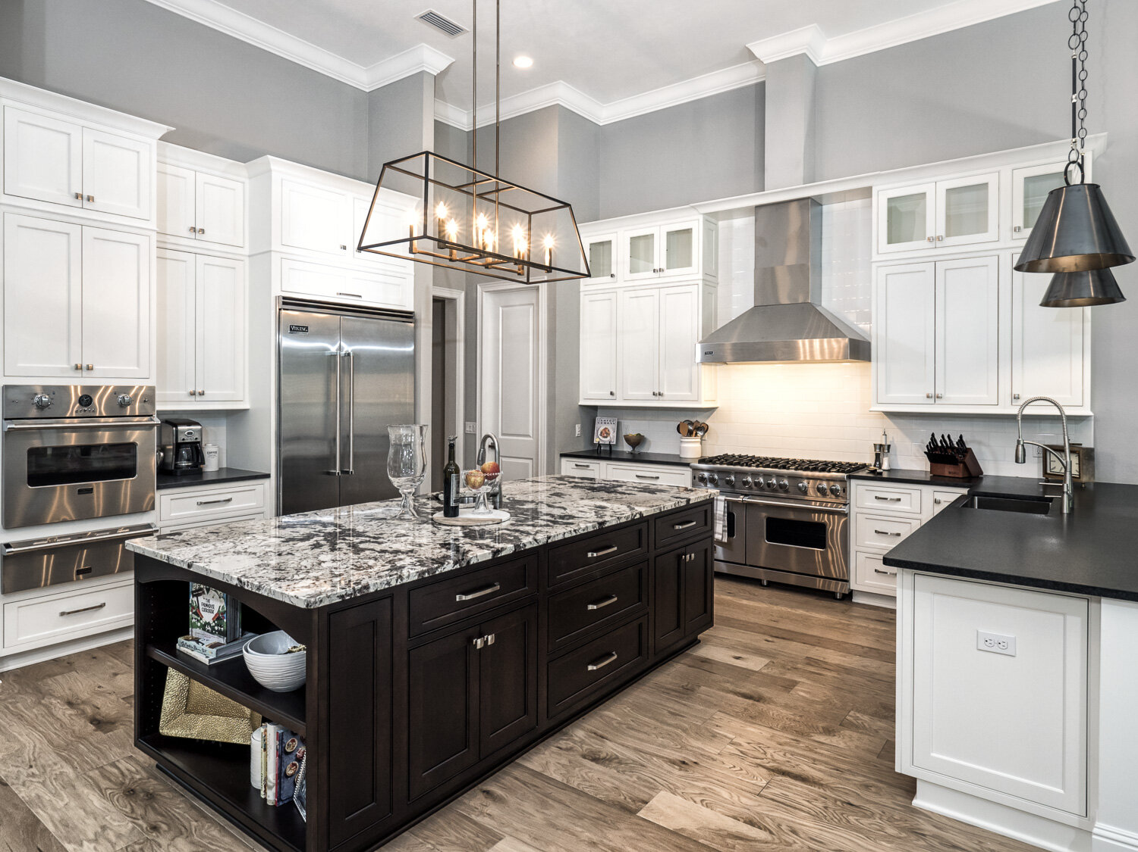




RNA-Seq Kitchen (Environment)
R
limma
DESeq
edgeR

Slide 26
Why do we need to learn two languages?
Automation
Machine Learning
Image Analysis
Complex workflows
HPC integration
RNA Seq pipelines
Statistics and Data Viz
Reproducibility
RNA-seq analysis (BioConductor)

Slide 27

Won’t it be confusing and hard?
There are a lot of similarities:
variables
functions
data structures
vectorized operations
dataframes
packages
reproducible workflows
You have excellent instructors and AI support!

Slide 28
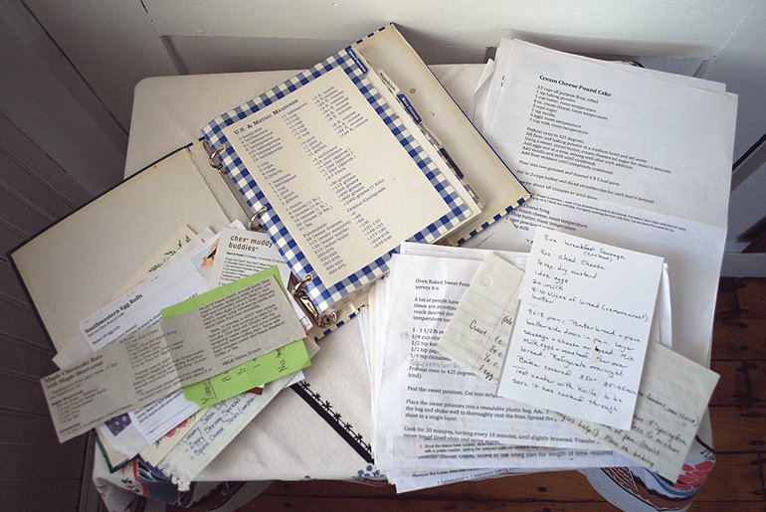
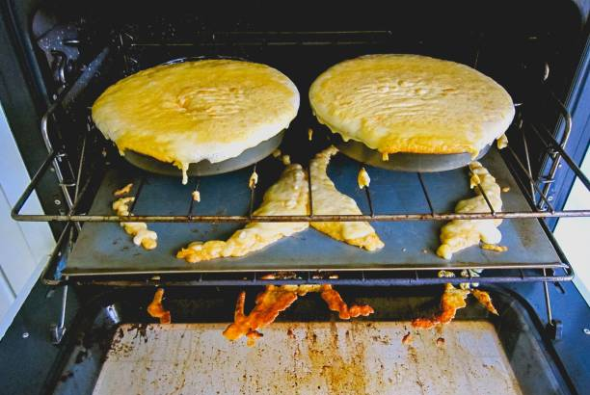
Keeping good notes while coding

Slide 29
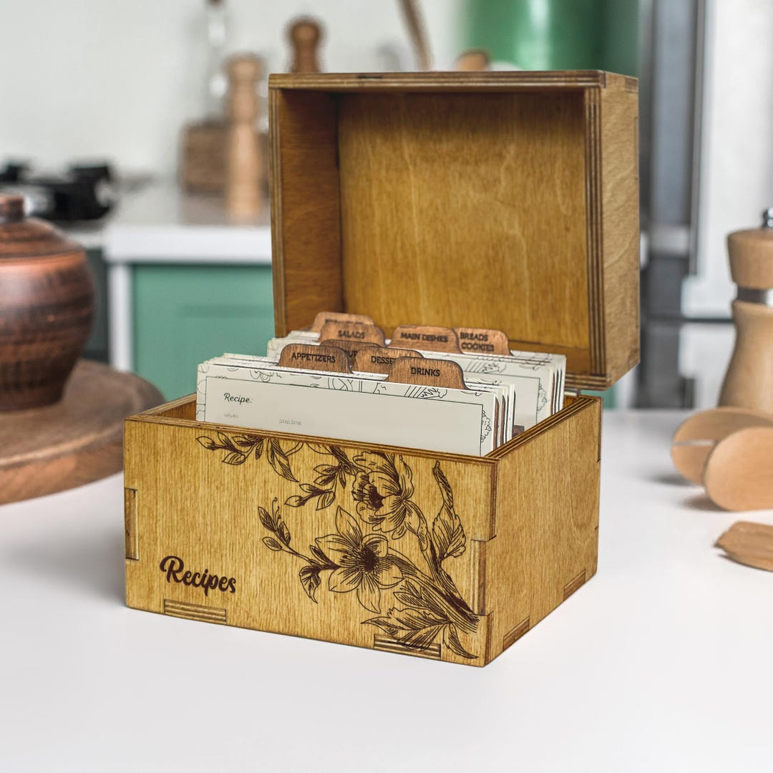
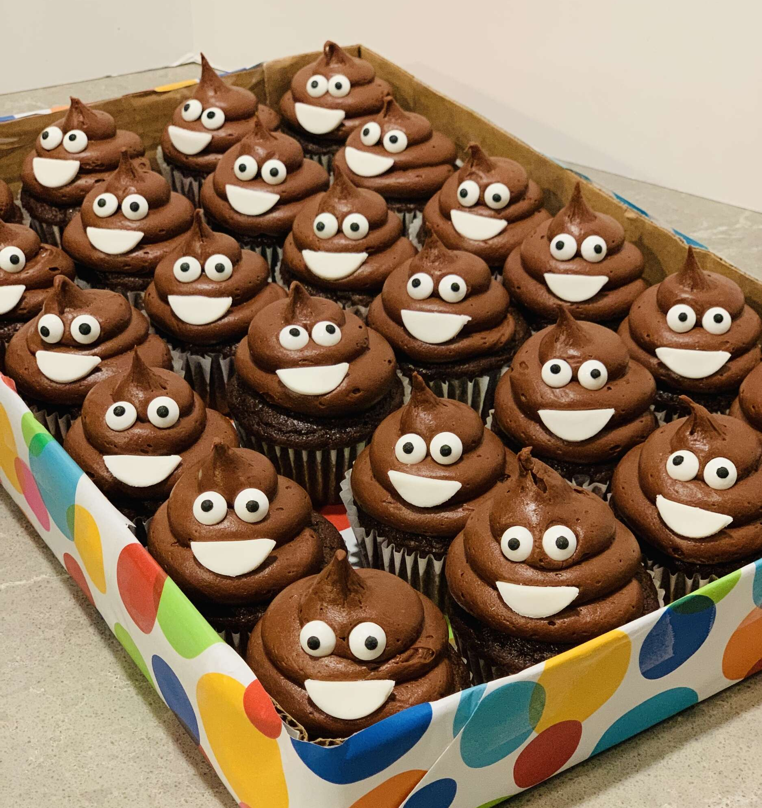
Notebooks and Version Control……

Slide 30



Interactive documents/notebooks where you can run code and store as HTML, PDF etc
R markdown
Notebook contains the code, instructions for using it and explanation of what it does

Slide 31



Version Control System
Tracks changes to your files
Facilitates Collaboration
Cloud Service to host your Git Repositories (Repos)
REPRODUCIBILITY
Works with R and Python

Slide 32
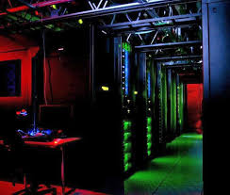
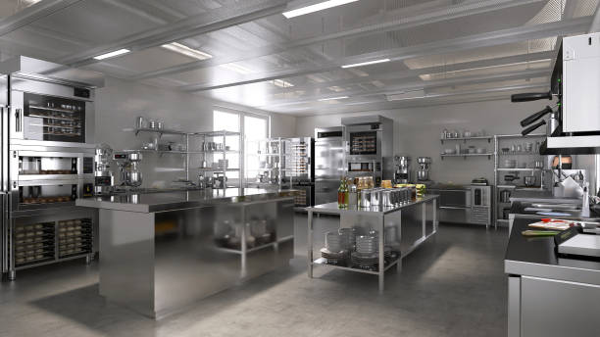
ALPINE
High Performance Computer
Located in Boulder
Need Boulder Account to use it
AKA an Industrial Kitchen – for large scale projects that are too big for your laptop

Slide 33
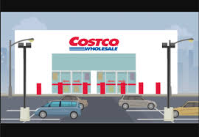
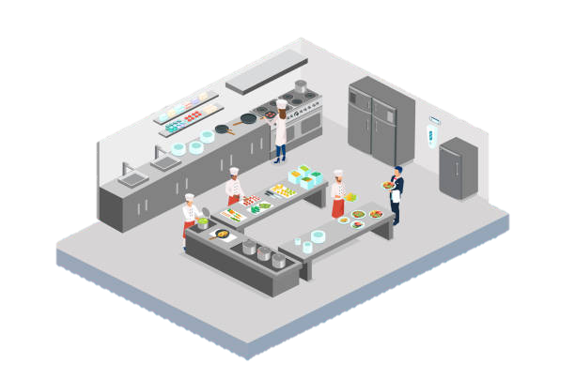






Package & Environment Manager
Anaconda
Packages
HPC (Alpine)
MiniCONDA
Environments
Command line
Git/Github
Git/Github
Version Control
jupyter
Code & Notebook
R markdown
packages
Product
Python
VSCode
R
RStudio
Language
IDE
Note that R and Python can also be run outside of Conda!

Slide 34
Final Projects
Design your own, or we are developing some ideas
These can be done on your own or in pairs
The goal is for you to use what you learned and push yourself a bit beyond what we teach you!
Presentations during the last week of classes, more details to follow

Slide 35

AI Disclosure for this Presentation
I used Gemini, and MS Copilot
To generate the Spreadsheet Sorcerer Image
To help me answer the question “What does all this stuff you made me put on my laptop do?”
To brainstorm analogies to explain the software packages, and different levels of coding experience

